Slide 1

Panopoulo junior high school
Ημερήσιο Γυμνάσιο Πανόπουλου-Παρουσίαση σχολείου
2024-2025

Slide 2
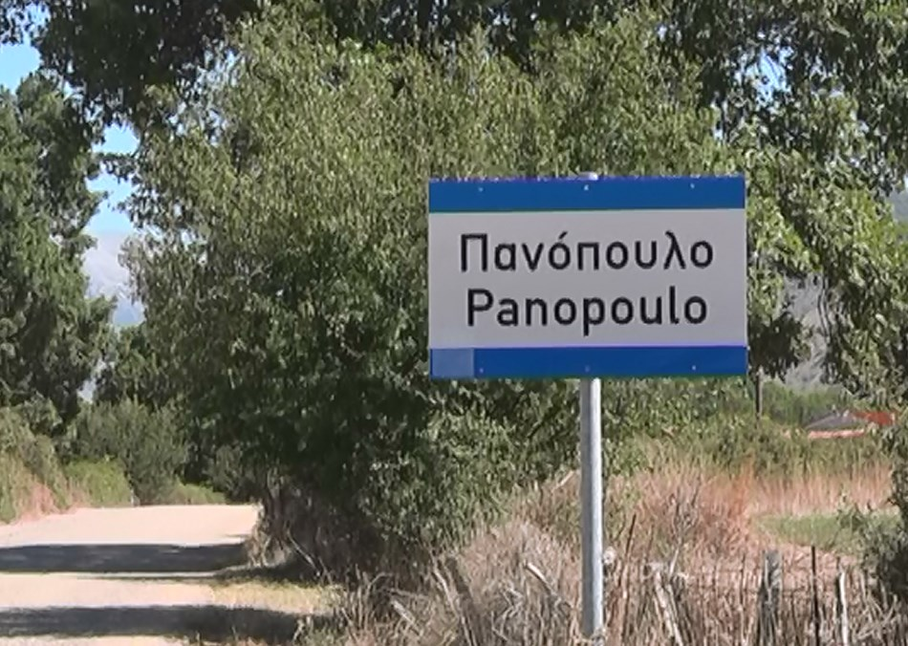
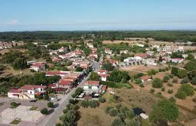
-Located In Peloponnese, Greece
-Altitude: 590 Meters
-Permanent Residents: 248

Slide 3
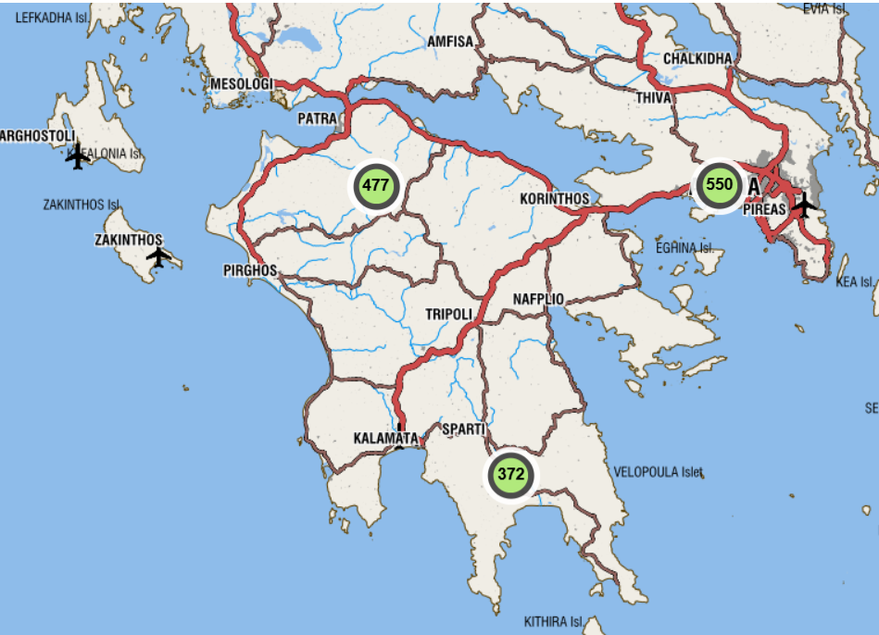

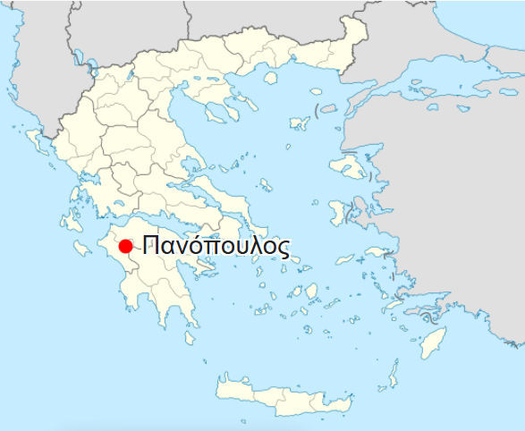


Location
-41 km from Ancient Olympia,
-39 km from Pyrgos, capital city in Ilia,
-58-60 km from Patras, capital of the Peloponnese prefecture.
- Rural area: people work in agriculture and animal breeding- producers of typical Greek products: olive oil, feta cheese….
/Panopoulo

Slide 4
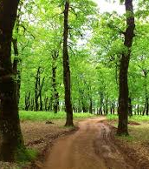
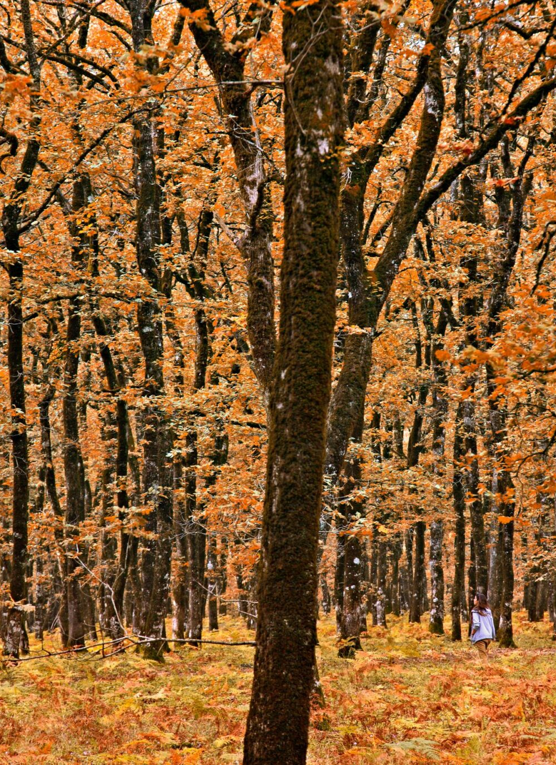
Natural landscape
Near the Foloe oak forest.
Mythical place: Hercules completed one of his labors here. Inhabited by Centaurs.

Slide 5
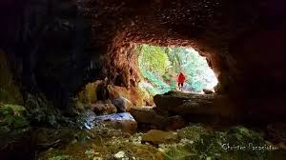
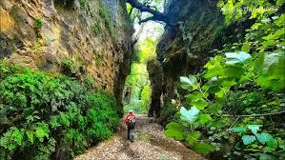
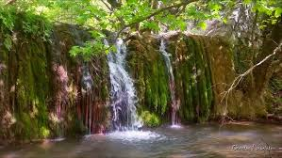
Sipreni Gorge

Slide 6
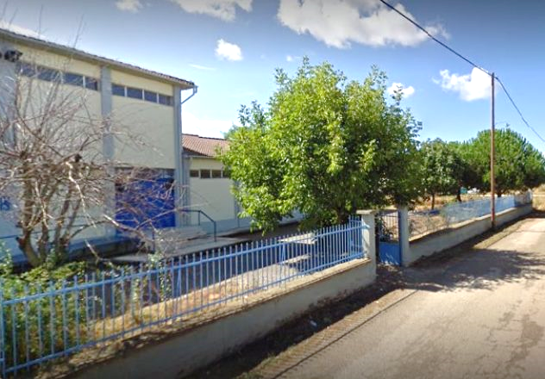
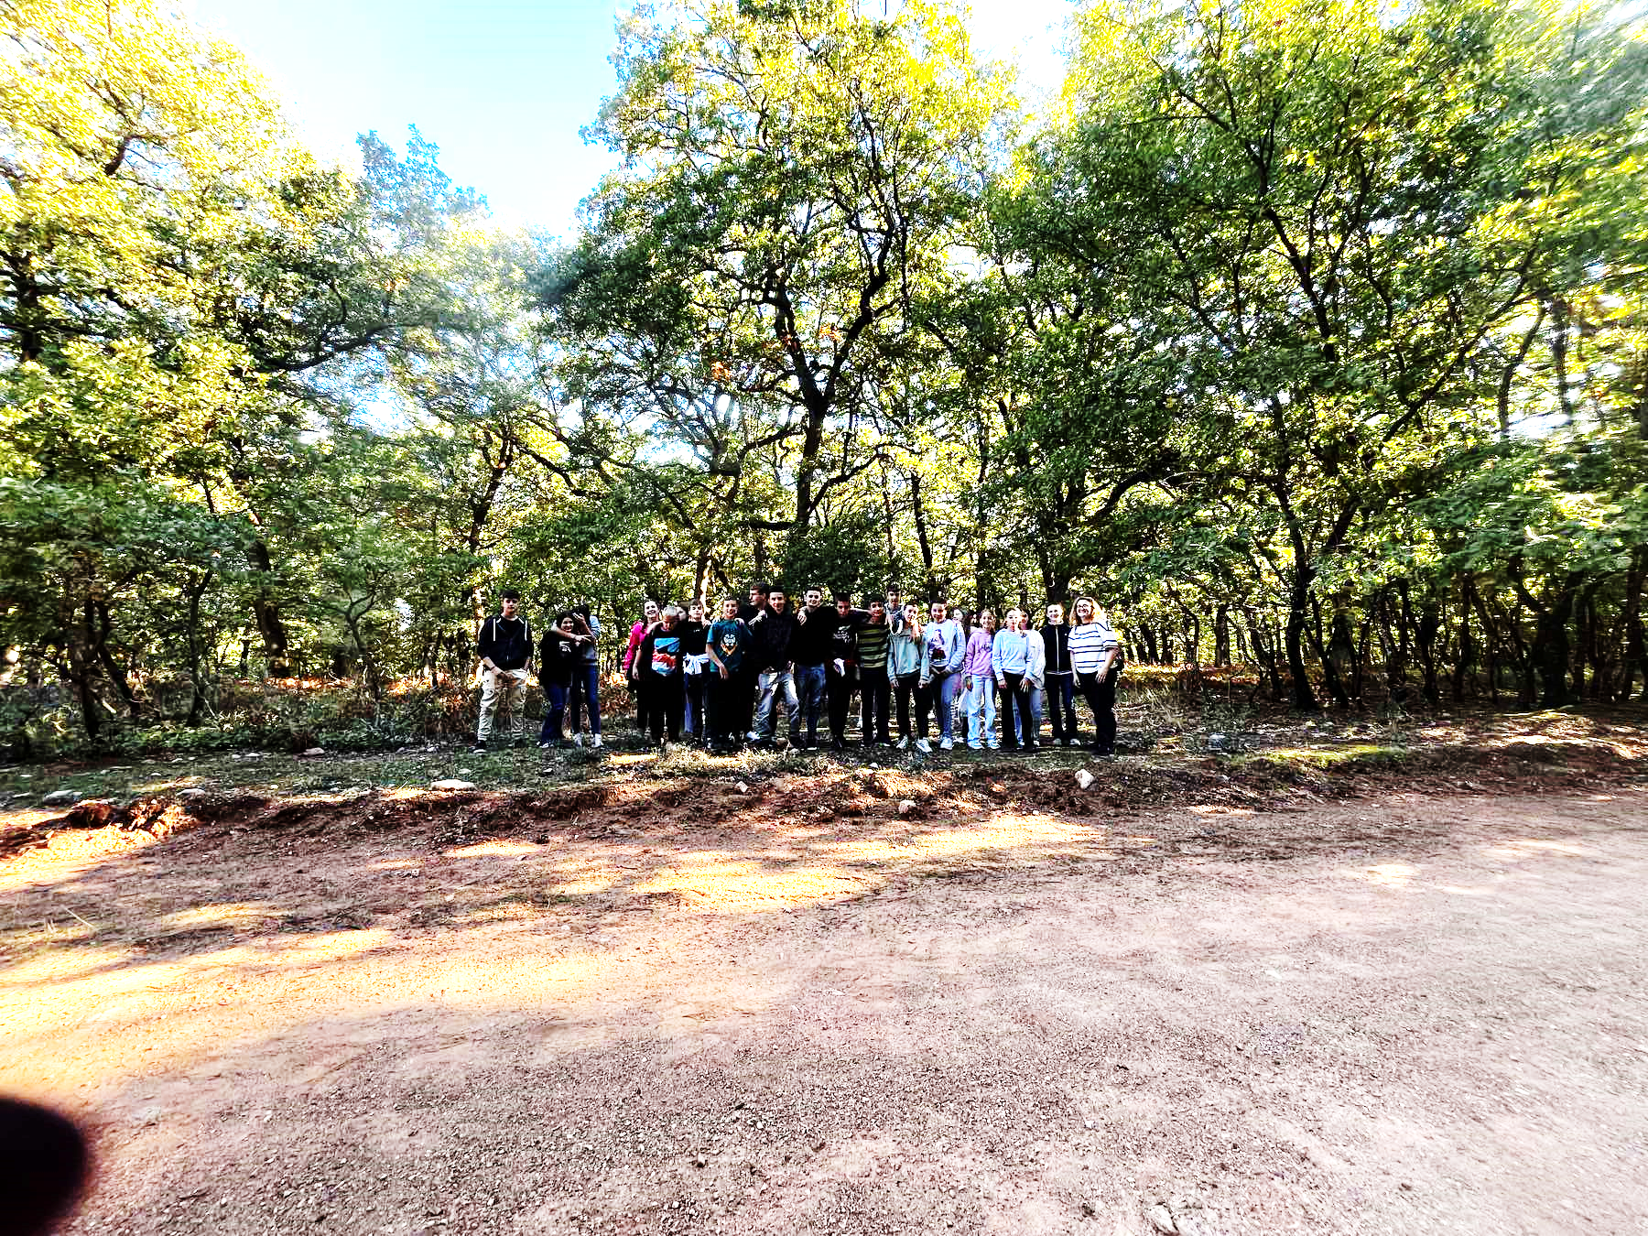
Our school
Junior High School -Ages: 13-15.
29 students in total in the three grades of High School.
Our students gather from different near -by villages.
Expectations from the program: Cultural awareness- openminded and confident students-artistic creation- getting to know life beyond the narrow confinements due to the seclusion of the village’s geographical location.

